Slide 1
GCP Lecture 5 PBR Part 2
Dr Leigh McLoughlin
lmcloughlin@bournemouth.ac.uk

Slide 2
Intro
PBR Schedule:
First lecture:
Intro – motivations, etc
Overview
Equations!
Why there are so many equations for the same thing
Second lecture:
Radiometry
Photometry
Camera
Lights
Sampling, Monte Carlo Integration

Slide 3
Intro
Today
Today’s lecture provides some formalities for things we’ve already looked at
Technically it’s like a missing link, but you probably didn’t realise it was missing ;)
Unfortunately there’s far too much to cover in one lecture (we’d need an entire degree for some of this stuff)
Here’s a very helpful starting point: http://www.pbr-book.org

Slide 4
Intro
Radiometry

Slide 5
Intro
Radiometry
Formal methods for measuring and describing electromagnetic radiation
For us, we’re interested in the visible wavelengths we call light
It gives us a set of mathematical terms and formulas, many of which we’ve actually seen before
These are what allow us to write the rendering equation

Slide 6
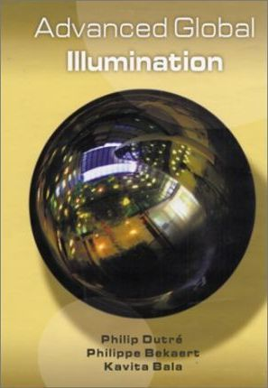
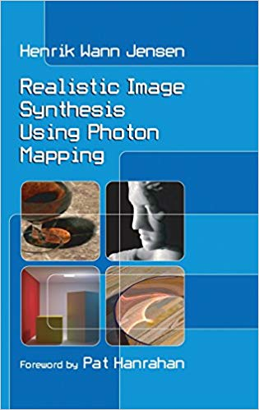
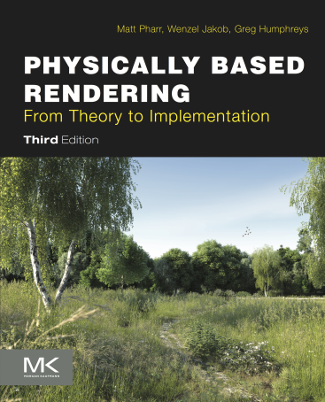
Intro
Radiometry
If you look at any book on rendering, their explanations will be based on Radiometry
It’s a massive topic but we’ll introduce the basics, which should get you through the first few pages of these books ;)

Slide 7
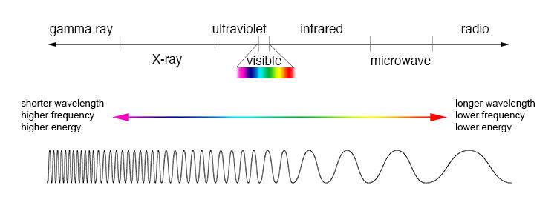
Intro
Light Introduction
What we perceive as ‘light’ is part of the electromagnetic spectrum
http://imagine.gsfc.nasa.gov/Images/science/EM_spectrum_compare_level1_lg.jpg

Slide 8
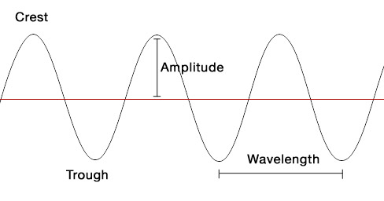
Intro
Light Introduction
Light can behave as a wave or a particle (further reading: wave-particle duality)
Its fundamental properties are wavelength and amplitude
A particle of light is called a photon (these have a wavelength and energy which relates to amplitude)

Slide 9
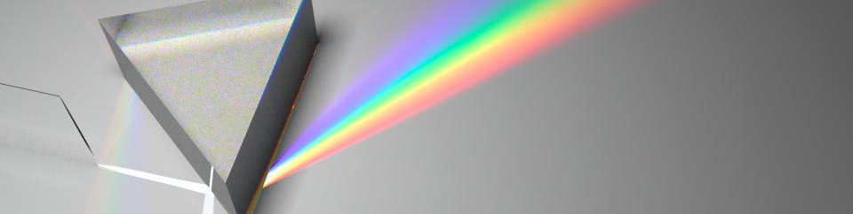
Radiometry
Radiometry Intro
Radiometry is the physics topic that studies light, how it moves through (propagates) and interacts with an environment (reflections)
It is largely based on the particle model of light
https://forums.luxcorerender.org/viewtopic.php?t=448

Slide 10
Radiometry
Common Assumptions
Mostly interested in objects larger than the wavelength of light
This discounts things like diffraction, interference patterns
Can be awkward for some optics problems, but makes equations much simpler
Linearity: effects of multiple lights are just added together
Polarisation can break this, so…
No polarisation
No interaction at atomic level - no fluorescence or phosphorescence
This effect can effectively change one wavelength to another; or luminescence in general

Slide 11
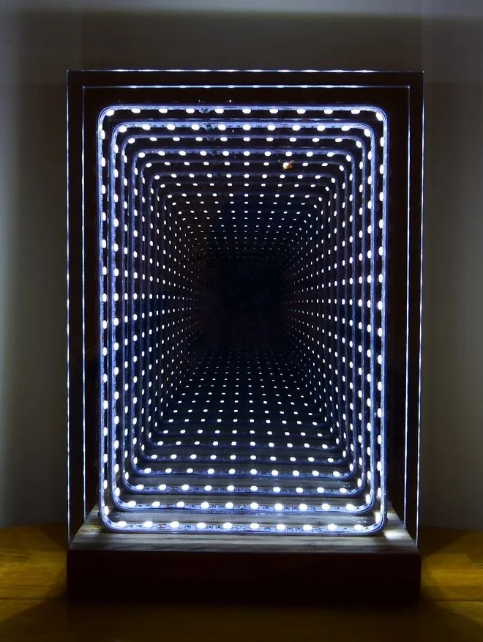
Radiometry
Common Assumptions
Steady state
This one’s subtle but interesting
When an emitter is turned on, it takes time for its light to travel throughout the scene
An equilibrium point is then reached where light is absorbed as fast as it’s emitted
Light is very fast, so in reality this happens nearly instantaneously
When an emitter’s or object’s properties are changed, we assume its effects are instantaneous
http://www.pbr-book.org/3ed-2018/Color_and_Radiometry/Radiometry.html
https://www.instructables.com/id/Modern-Led-Infinity-Mirror-Table-Lamp/

Slide 12
Radiometry
Basic Quantities
We need to define the following basic quantities:
Energy
Flux
Irradiance and Radiant Exitance (Radiosity)
Solid Angle
Intensity
Radiance

Slide 13
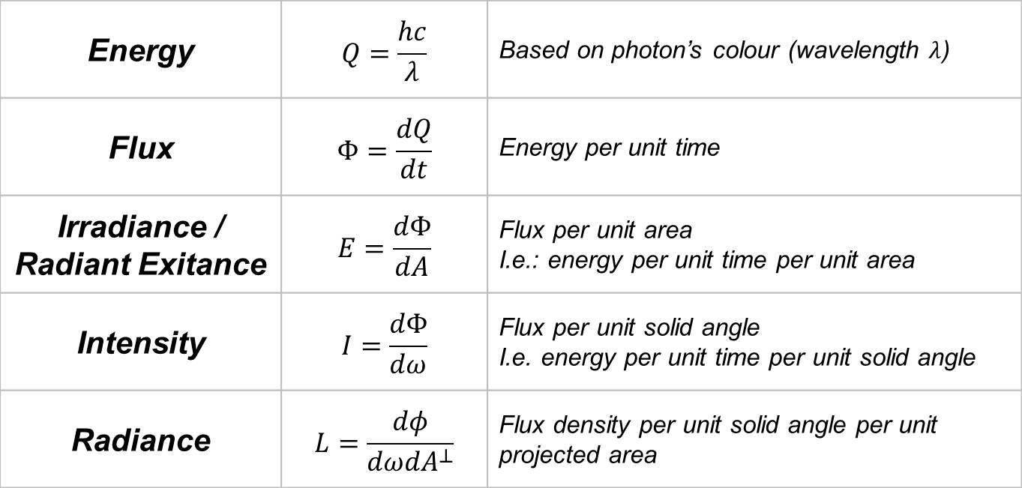
Radiometry
Basic Quantities – Summary Sheet
Energy | $$Q=\frac{hc}{λ}$$ | Based on photon’s colour (wavelength $λ$)
Flux | $$Φ=\frac{dQ}{dt}$$ | Energy per unit time
Irradiance / Radiant Exitance | $$E=\frac{dΦ}{dA}$$ | Flux per unit area I.e.: energy per unit time per unit area
Intensity | $$I=\frac{dΦ}{dω}$$ | Flux per unit solid angle I.e. energy per unit time per unit solid angle
Radiance | $$L=\frac{dφ}{dωdA^{⊥}}$$ | Flux density per unit solid angle per unit projected area

Slide 14
Radiometry
Energy

Slide 15
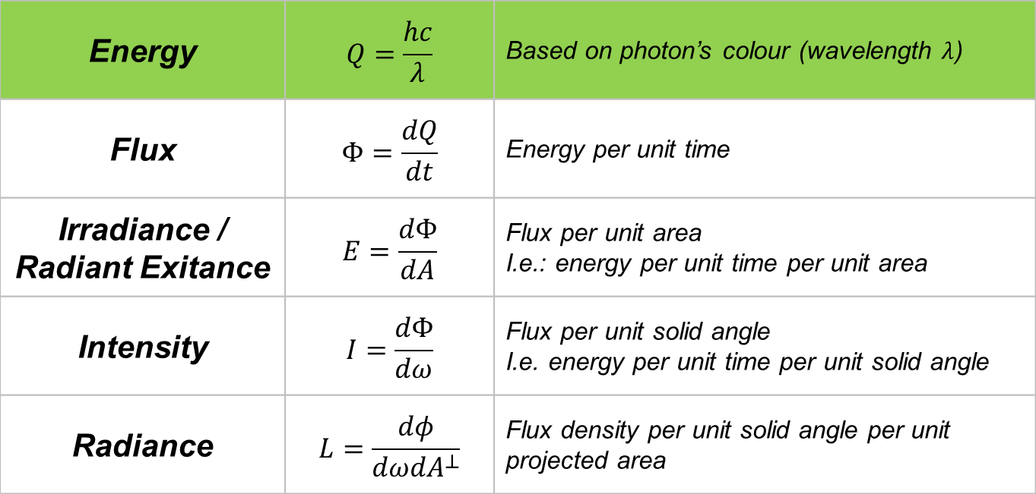
Radiometry
Basic Quantities – Summary Sheet
Energy | $$Q=\frac{hc}{λ}$$ | Based on photon’s colour (wavelength $λ$)
Flux | $$Φ=\frac{dQ}{dt}$$ | Energy per unit time
Irradiance / Radiant Exitance | $$E=\frac{dΦ}{dA}$$ | Flux per unit area I.e.: energy per unit time per unit area
Intensity | $$I=\frac{dΦ}{dω}$$ | Flux per unit solid angle I.e. energy per unit time per unit solid angle
Radiance | $$L=\frac{dφ}{dωdA^{⊥}}$$ | Flux density per unit solid angle per unit projected area

Slide 16

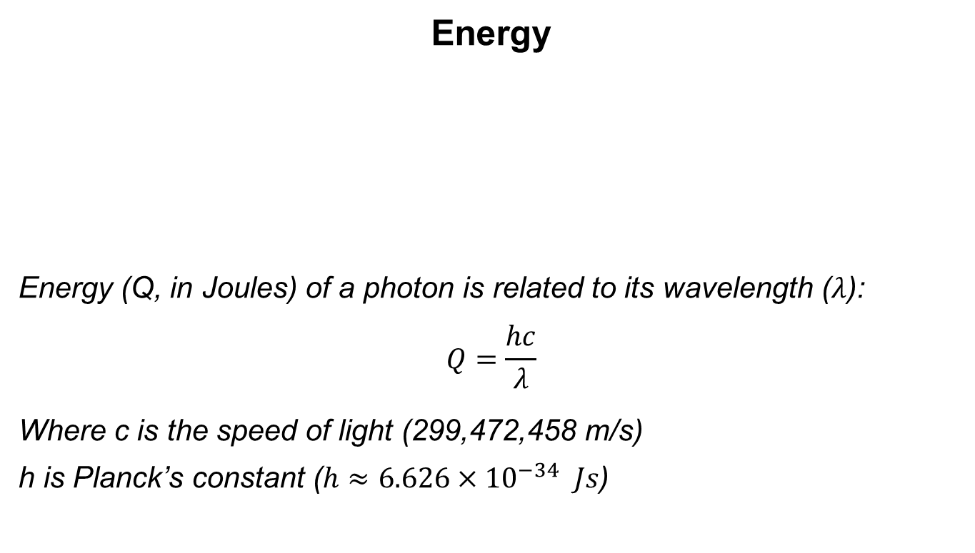
Radiometry
Energy
Energy (Q, in Joules) of a photon is related to its wavelength ($λ$):
$$Q=\frac{hc}{λ}$$
Where c is the speed of light (299,472,458 m/s)
h is Planck’s constant ($h≈6.626×{10}^{−34} Js$)

Slide 17
Radiometry
Flux

Slide 18
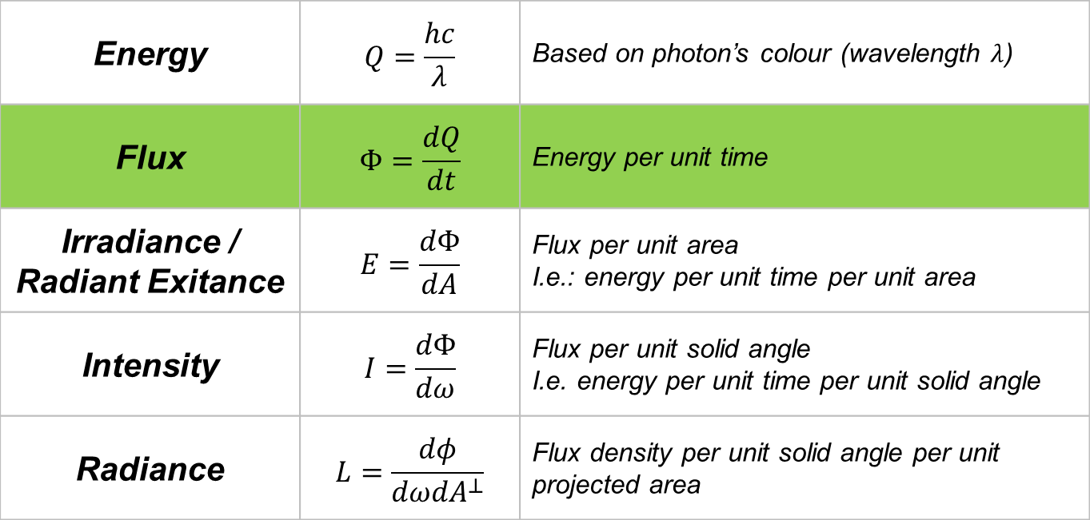
Radiometry
Basic Quantities – Summary Sheet
Energy | $$Q=\frac{hc}{λ}$$ | Based on photon’s colour (wavelength $λ$)
Flux | $$Φ=\frac{dQ}{dt}$$ | Energy per unit time
Irradiance / Radiant Exitance | $$E=\frac{dΦ}{dA}$$ | Flux per unit area I.e.: energy per unit time per unit area
Intensity | $$I=\frac{dΦ}{dω}$$ | Flux per unit solid angle I.e. energy per unit time per unit solid angle
Radiance | $$L=\frac{dφ}{dωdA^{⊥}}$$ | Flux density per unit solid angle per unit projected area

Slide 19
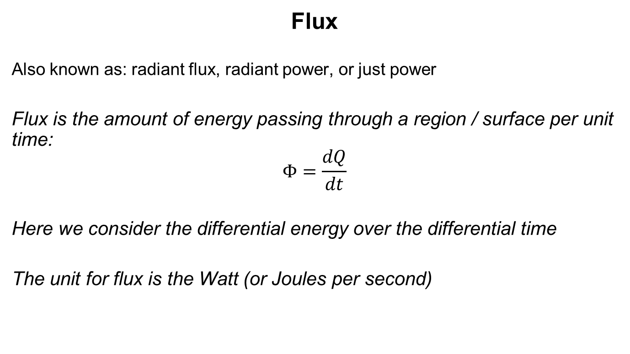
Radiometry
Flux
Also known as: radiant flux, radiant power, or just power
Flux is the amount of energy passing through a region / surface per unit time:
$$Φ=\frac{dQ}{dt}$$
Here we consider the differential energy over the differential time
The unit for flux is the Watt (or Joules per second)

Slide 20
Radiometry
Flux
Flux can be thought of as considering:
The number of photons passing through an area of unspecific size
And the energy of those photons (which is related to their wavelength)
(By itself you can’t figure out if it’s lots of lower energy photons or fewer high energy photons)

Slide 21
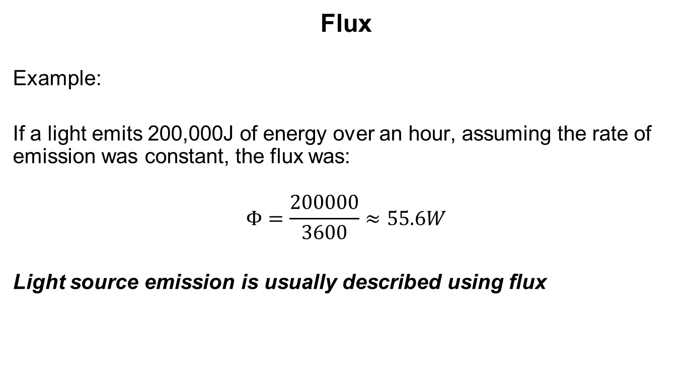
Radiometry
Flux
Example:
If a light emits 200,000J of energy over an hour, assuming the rate of emission was constant, the flux was:
$$Φ=\frac{200000}{3600}≈55.6W$$
Light source emission is usually described using flux

Slide 22
Radiometry
Flux
Consider a point light

Slide 23
Radiometry
Flux
Consider a point light
Flux will describe the total amount of light energy received at the surface of the whole sphere

Slide 24
Radiometry
Flux
Consider a point light
A larger sphere has a larger area
But the flux (total amount of energy) is the same
You have to specify a region, but actual area simply isn’t considered

Slide 25
Radiometry
Irradiance

Slide 26
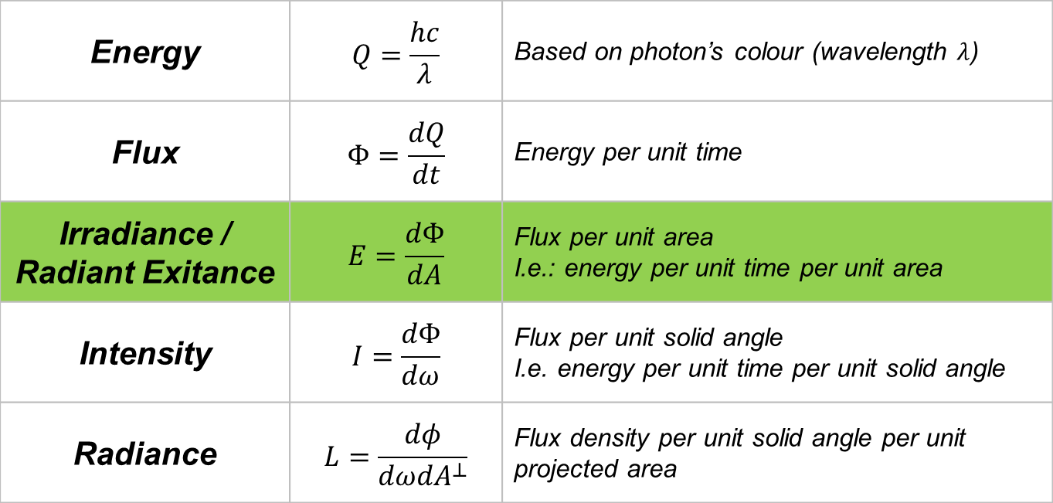
Radiometry
Basic Quantities – Summary Sheet
Energy | $$Q=\frac{hc}{λ}$$ | Based on photon’s colour (wavelength $λ$)
Flux | $$Φ=\frac{dQ}{dt}$$ | Energy per unit time
Irradiance / Radiant Exitance | $$E=\frac{dΦ}{dA}$$ | Flux per unit area I.e.: energy per unit time per unit area
Intensity | $$I=\frac{dΦ}{dω}$$ | Flux per unit solid angle I.e. energy per unit time per unit solid angle
Radiance | $$L=\frac{dφ}{dωdA^{⊥}}$$ | Flux density per unit solid angle per unit projected area

Slide 27
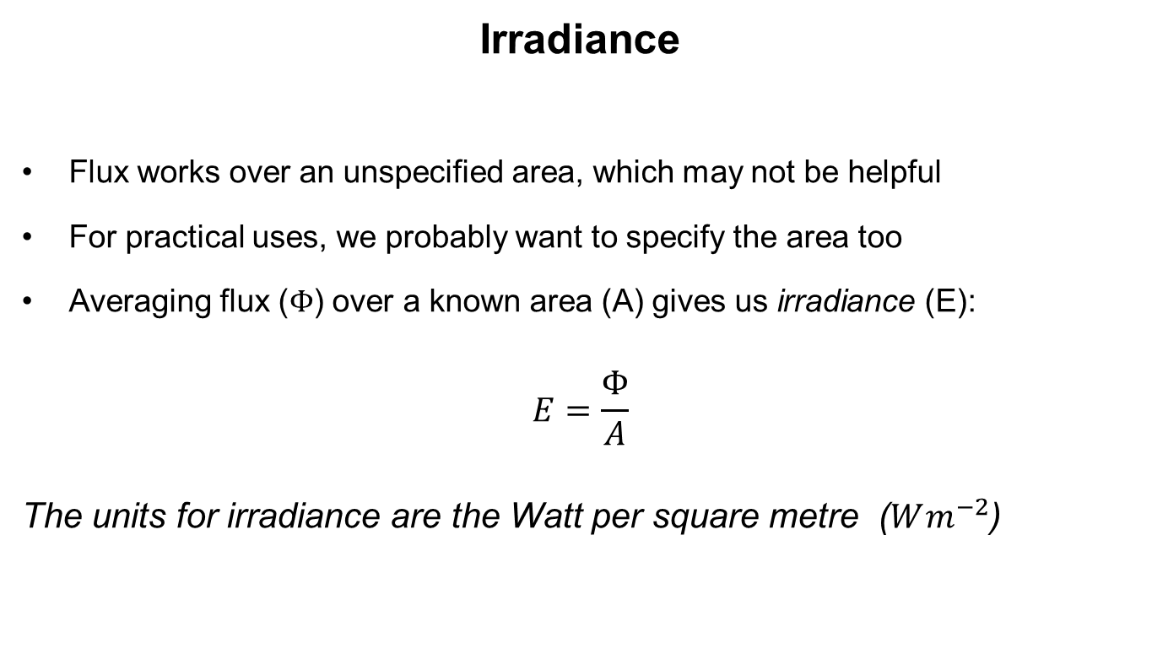
Radiometry
Irradiance
Flux works over an unspecified area, which may not be helpful
For practical uses, we probably want to specify the area too
Averaging flux ($Φ$) over a known area (A) gives us irradiance (E):
$$E=\frac{Φ}{A}$$
The units for irradiance are the Watt per square metre ($Wm^{−2}$)

Slide 28
Radiometry
Irradiance
Irradiance can be thought of as considering:
The number of photons passing through a specific area
And the energy of those photons (which is related to their wavelength)
(Again, by itself you can’t figure out if it’s lots of lower energy photons or fewer high energy photons)

Slide 29
Radiometry
Irradiance
Actually there are two related terms:
Irradiance
Light arriving at a surface
Radiant Exitance
Light leaving a surface

Slide 30
Radiometry
Irradiance
Consider a point light

Slide 31
Radiometry
Irradiance
Consider a point light
Irradiance will describe the amount of light energy received by point on a sphere of a specific size

Slide 32
Radiometry
Irradiance
Consider a point light
A larger sphere has a larger area, but the flux (amount of energy) is the same
So the amount of energy at each point on the larger sphere is less
Therefore the irradiance must be reduced

Slide 33
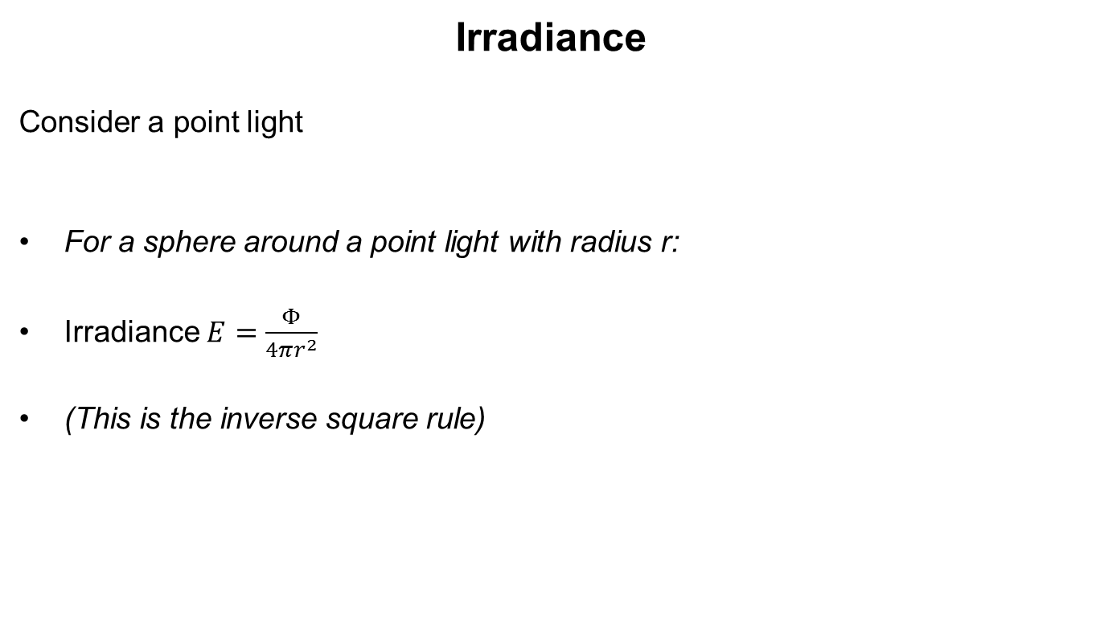
Radiometry
Irradiance
Consider a point light
For a sphere around a point light with radius r:
Irradiance $E=\frac{Φ}{4πr^{2}}$
(This is the inverse square rule)

Slide 34
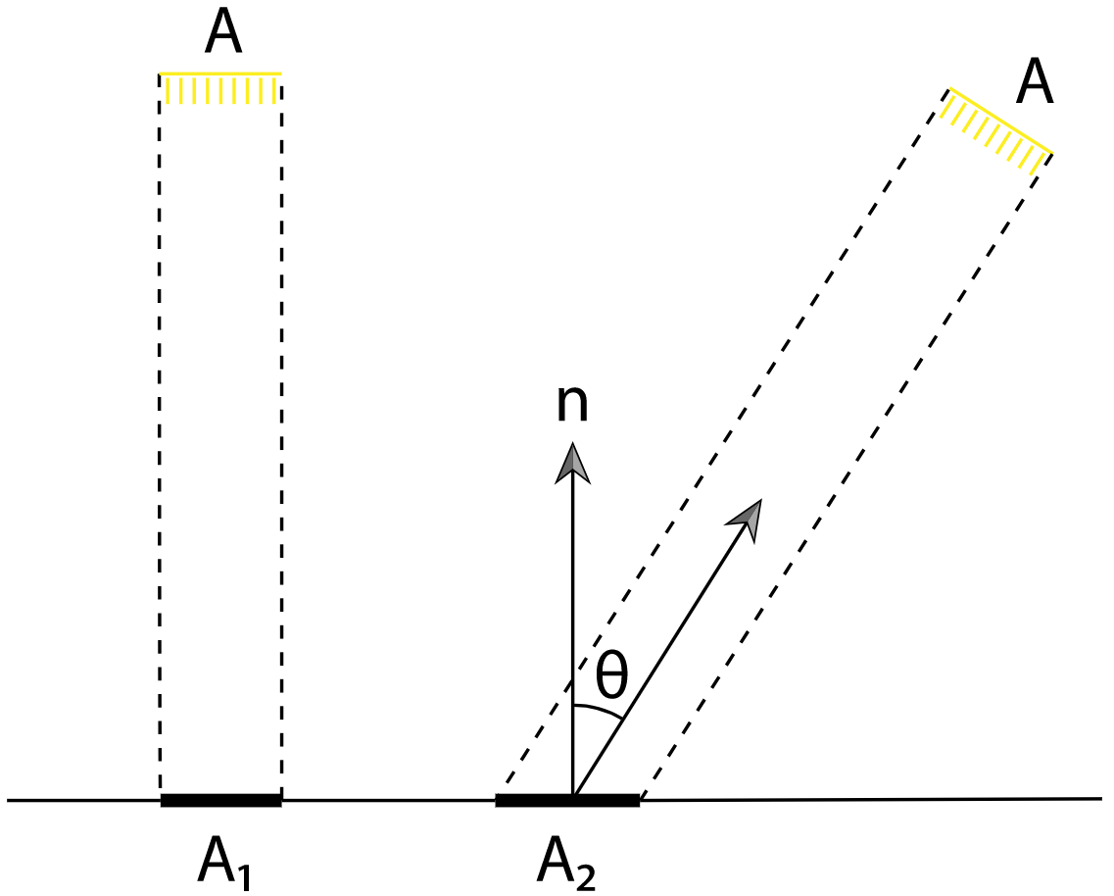
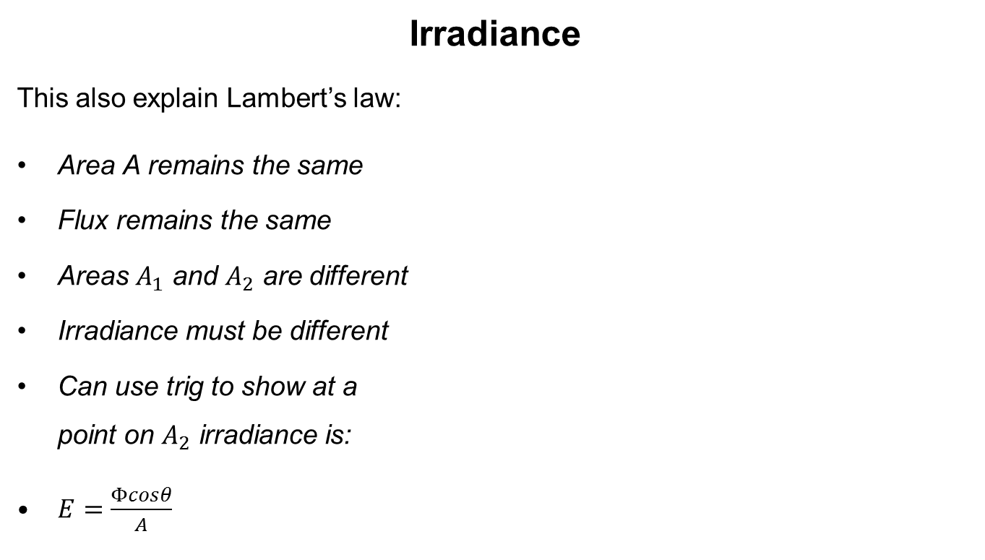
Radiometry
Irradiance
This also explain Lambert’s law:
Area A remains the same
Flux remains the same
Areas $A_{1}$ and $A_{2}$ are different
Irradiance must be different
Can use trig to show at a point on $A_{2}$ irradiance is:
$E=\frac{Φcosθ}{A}$

Slide 35

Radiometry
Irradiance
The trig:
Zoom in on A
Look for triangles
A
$$θ$$
A₂

Slide 36
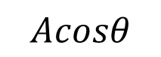
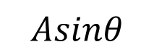

Radiometry
Irradiance
The trig:
Zoom in on A
Look for triangles
A
$$Asinθ$$
$$Acosθ$$
$$θ$$
A₂

Slide 37


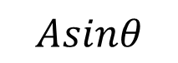
Radiometry
Irradiance
The trig:
A
$$θ$$
$$Asinθ$$
$$b$$
$$Acosθ$$
$$θ$$
A₂

Slide 38

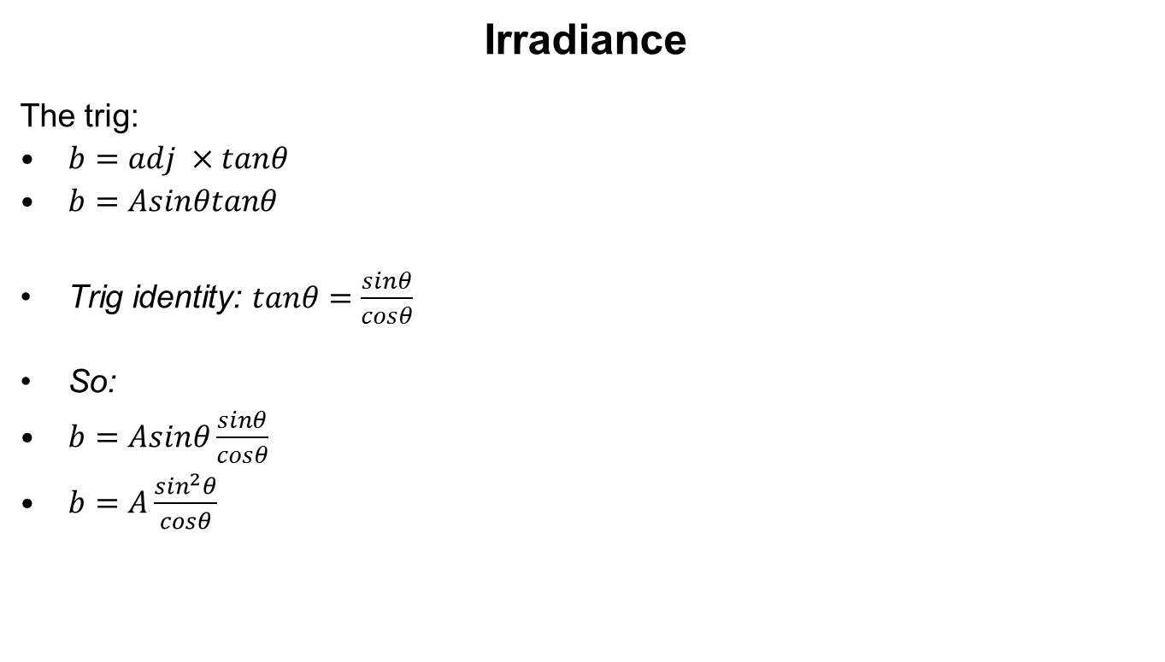

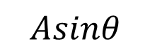

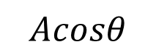
Radiometry
Irradiance
The trig:
$b=adj ×tanθ$
$b=Asinθtanθ$
Trig identity: $tanθ=\frac{sinθ}{cosθ}$
So:
$b=Asinθ\frac{sinθ}{cosθ}$
$b=A\frac{\sin^{2}θ}{cosθ}$
A
$$θ$$
$$Asinθ$$
$$b$$
$$Acosθ$$
$$θ$$
A₂

Slide 39
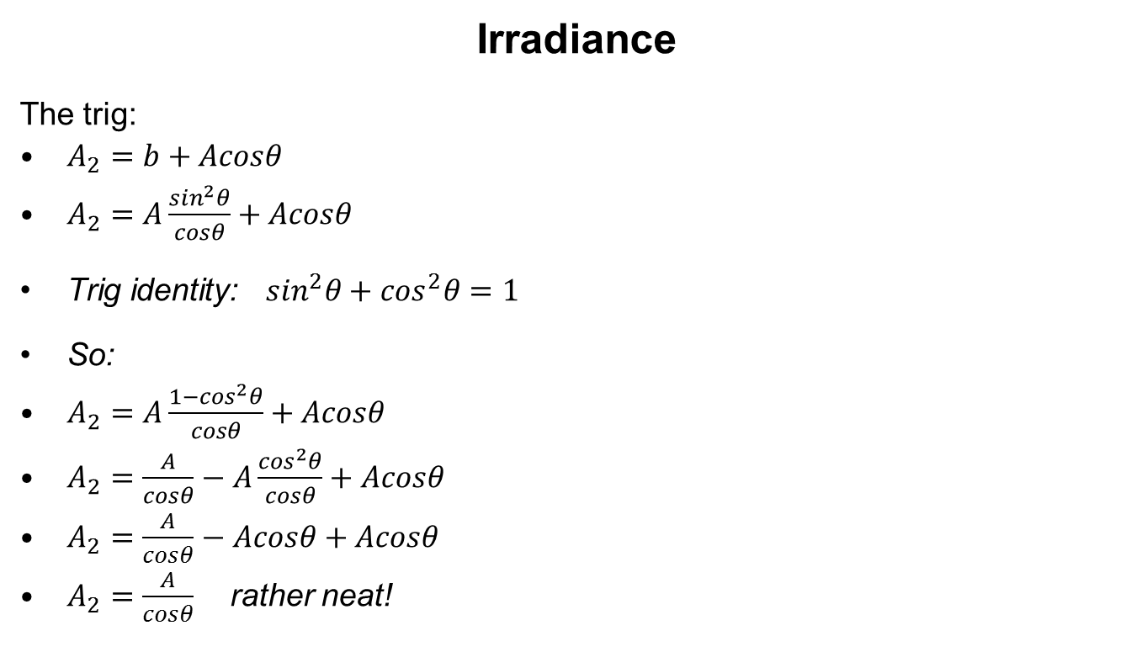
Radiometry
Irradiance
The trig:
$A_{2}=b+Acosθ$
$A_{2}=A\frac{\sin^{2}θ}{cosθ}+Acosθ$
Trig identity: $\sin^{2}θ+\cos^{2}θ=1$
So:
$A_{2}=A\frac{1−\cos^{2}θ}{cosθ}+Acosθ$
$A_{2}=\frac{A}{cosθ}−A\frac{\cos^{2}θ}{cosθ}+Acosθ$
$A_{2}=\frac{A}{cosθ}−Acosθ+Acosθ$
$A_{2}=\frac{A}{cosθ}$ rather neat!
A
$$θ$$
$$Asinθ$$
$$b$$
$$Acosθ$$
$$θ$$
A₂

Slide 40

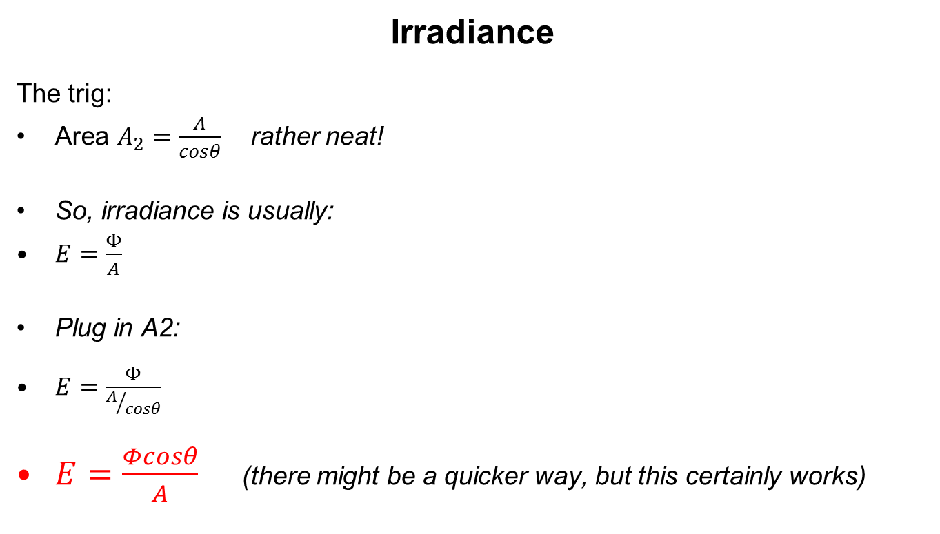
Radiometry
Irradiance
The trig:
Area $A_{2}=\frac{A}{cosθ}$ rather neat!
So, irradiance is usually:
$E=\frac{Φ}{A}$
Plug in A2:
$E=\frac{Φ}{A/{cosθ}}$
$E=\frac{Φcosθ}{A}$ (there might be a quicker way, but this certainly works)

Slide 41
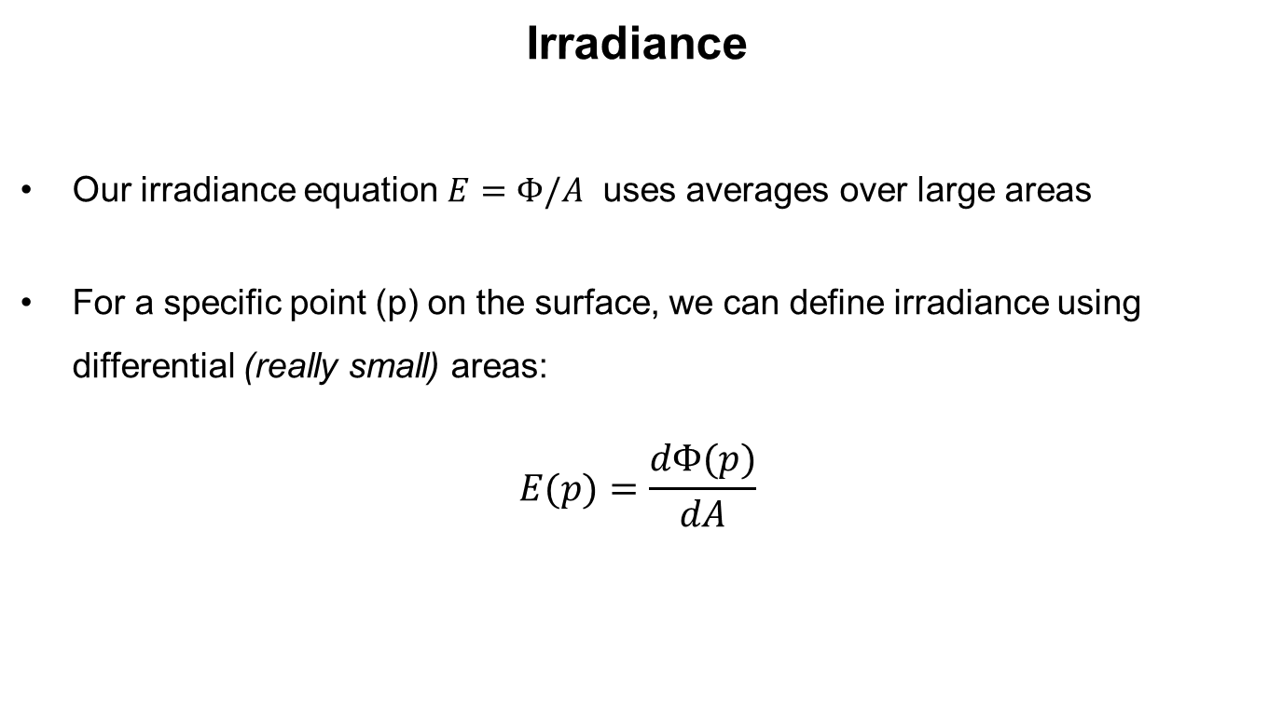
Radiometry
Irradiance
Our irradiance equation $E=Φ/A$ uses averages over large areas
For a specific point (p) on the surface, we can define irradiance using differential (really small) areas:
$$E(p)=\frac{dΦ(p)}{dA}$$

Slide 42
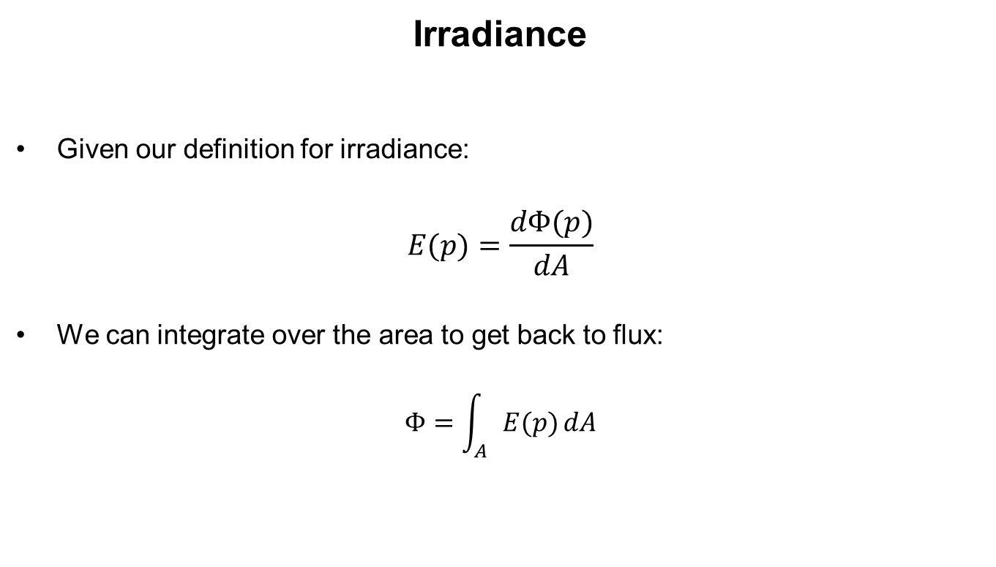
Radiometry
Irradiance
Given our definition for irradiance:
$$E(p)=\frac{dΦ(p)}{dA}$$
We can integrate over the area to get back to flux:
$$Φ=\int_{A}{E(p)}dA$$

Slide 43
Radiometry
Solid Angles

Slide 44
Radiometry
Solid Angle
The solid angle is a combination of an angle and a radius on a unit sphere
r
A

Slide 45
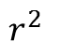
Radiometry
Solid Angle
The solid angle is a combination of an angle and an area on a unit sphere
Its unit is the steradian (sr), where the area is the radius squared
r
$$r^{2}$$

Slide 46
Radiometry
Solid Angle
We can project a shape onto the surface of the sphere to find the solid angle it subtends
r
A

Slide 47
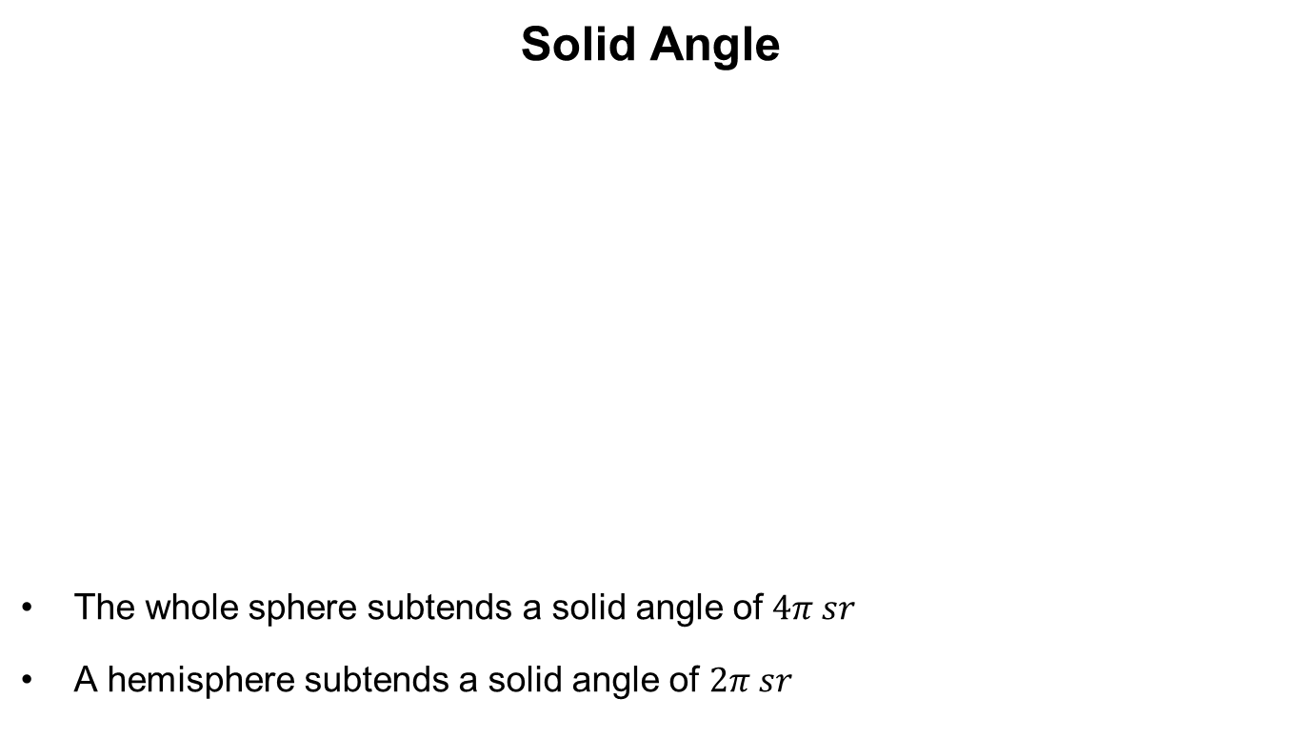
Radiometry
Solid Angle
The whole sphere subtends a solid angle of $4π sr$
A hemisphere subtends a solid angle of $2π sr$
r
$$r^{2}$$

Slide 48
Radiometry
Intensity

Slide 49
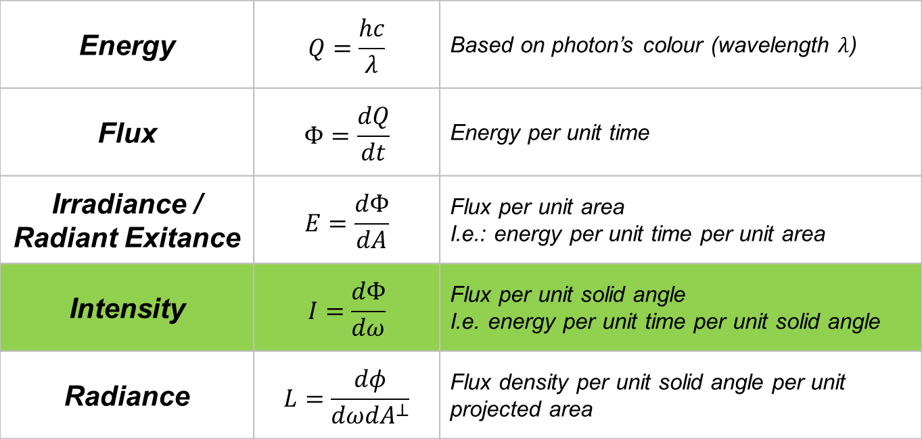
Radiometry
Basic Quantities – Summary Sheet
Energy | $$Q=\frac{hc}{λ}$$ | Based on photon’s colour (wavelength $λ$)
Flux | $$Φ=\frac{dQ}{dt}$$ | Energy per unit time
Irradiance / Radiant Exitance | $$E=\frac{dΦ}{dA}$$ | Flux per unit area I.e.: energy per unit time per unit area
Intensity | $$I=\frac{dΦ}{dω}$$ | Flux per unit solid angle I.e. energy per unit time per unit solid angle
Radiance | $$L=\frac{dφ}{dωdA^{⊥}}$$ | Flux density per unit solid angle per unit projected area

Slide 50
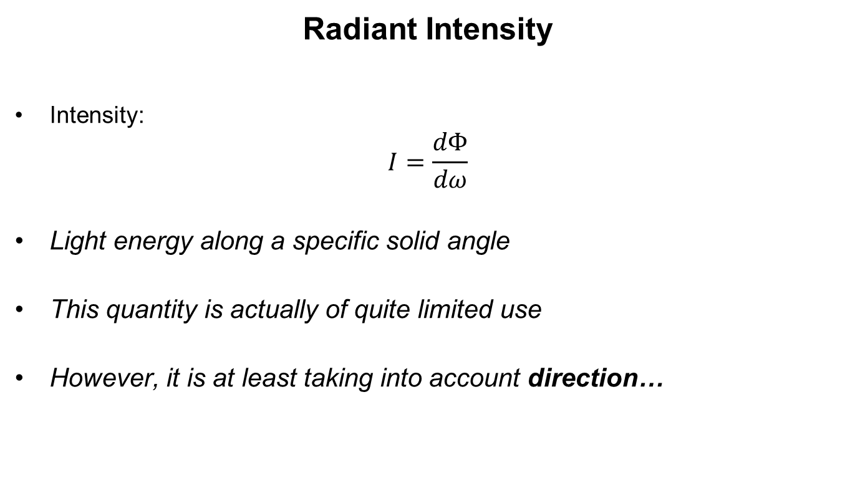
Radiometry
Radiant Intensity
Intensity:
$$I=\frac{dΦ}{dω}$$
Light energy along a specific solid angle
This quantity is actually of quite limited use
However, it is at least taking into account direction…

Slide 51
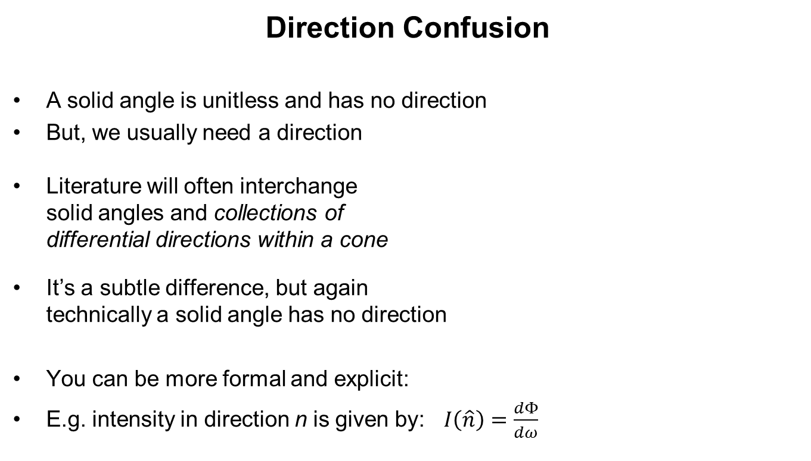
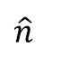
Radiometry
Direction Confusion
A solid angle is unitless and has no direction
But, we usually need a direction
Literature will often interchange solid angles and collections of differential directions within a cone
It’s a subtle difference, but again technically a solid angle has no direction
You can be more formal and explicit:
E.g. intensity in direction n is given by: $I\left(\hat{n}\right)=\frac{dΦ}{dω}$
$$\hat{n}$$
A

Slide 52
Radiometry
Radiance

Slide 53
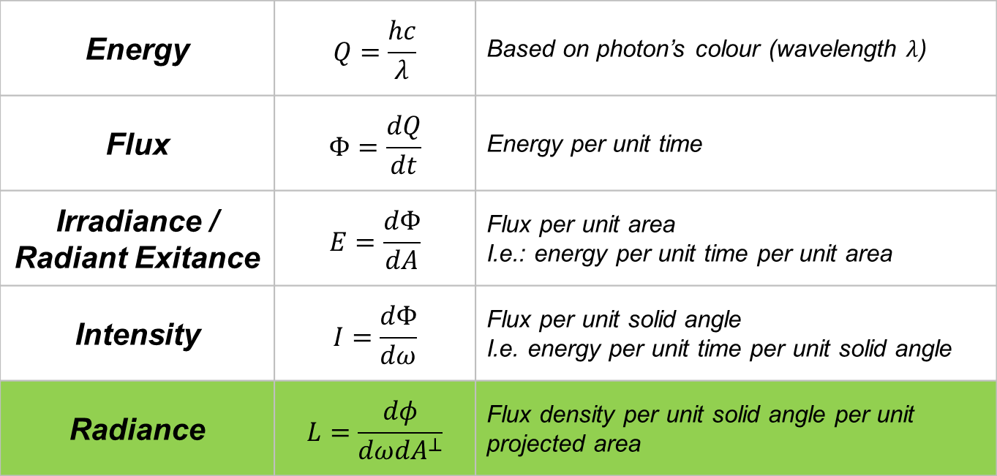
Radiometry
Basic Quantities – Summary Sheet
Energy | $$Q=\frac{hc}{λ}$$ | Based on photon’s colour (wavelength $λ$)
Flux | $$Φ=\frac{dQ}{dt}$$ | Energy per unit time
Irradiance / Radiant Exitance | $$E=\frac{dΦ}{dA}$$ | Flux per unit area I.e.: energy per unit time per unit area
Intensity | $$I=\frac{dΦ}{dω}$$ | Flux per unit solid angle I.e. energy per unit time per unit solid angle
Radiance | $$L=\frac{dφ}{dωdA^{⊥}}$$ | Flux density per unit solid angle per unit projected area

Slide 54
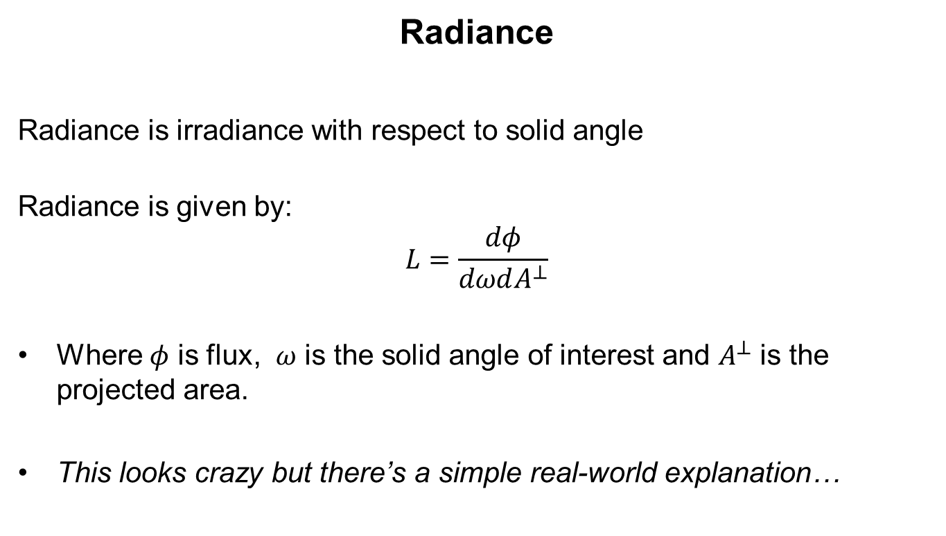
Radiometry
Radiance
Radiance is irradiance with respect to solid angle
Radiance is given by:
$$L=\frac{dφ}{dωdA^{⊥}}$$
Where $φ$ is flux, $ω$ is the solid angle of interest and $A^{⊥}$ is the projected area.
This looks crazy but there’s a simple real-world explanation…

Slide 55
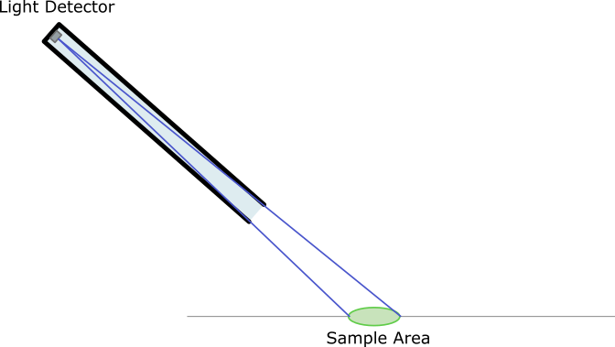
Radiometry
Radiance
It’s just the light that enters a detector at the end of a long tube!

Slide 56
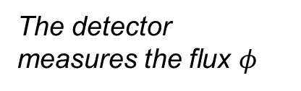
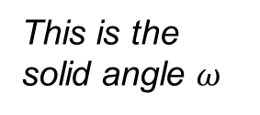
Radiometry
Radiance
It’s just the light that enters a detector at the end of a long tube!
The detector measures the flux $φ$
This is the solid angle $ω$

Slide 57
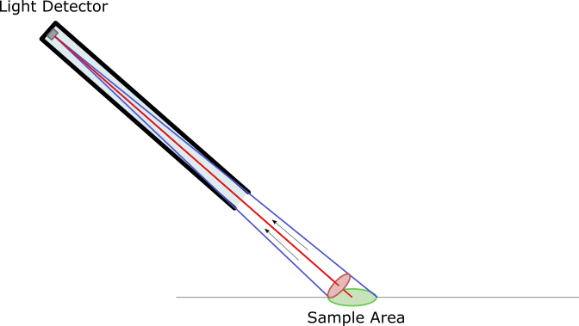
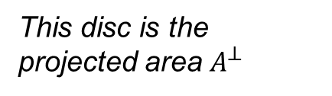
Radiometry
Radiance
It’s just the light that enters a detector at the end of a long tube!
This disc is the projected area $A^{⊥}$

Slide 58
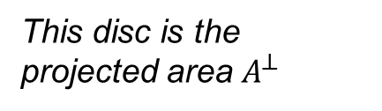
Radiometry
Radiance
(quick zoom to make it clearer)
The projected area takes into account the dot product too, making the equations slightly simpler than irradiance ones!
This disc is the projected area $A^{⊥}$

Slide 59
Radiometry
Basic Quantities – Summary Sheet
Energy | $$Q=\frac{hc}{λ}$$ | Based on photon’s colour (wavelength $λ$)
Flux | $$Φ=\frac{dQ}{dt}$$ | Energy per unit time
Irradiance / Radiant Exitance | $$E=\frac{dΦ}{dA}$$ | Flux per unit area I.e.: energy per unit time per unit area
Intensity | $$I=\frac{dΦ}{dω}$$ | Flux per unit solid angle I.e. energy per unit time per unit solid angle
Radiance | $$L=\frac{dφ}{dωdA^{⊥}}$$ | Flux density per unit solid angle per unit projected area

Slide 60
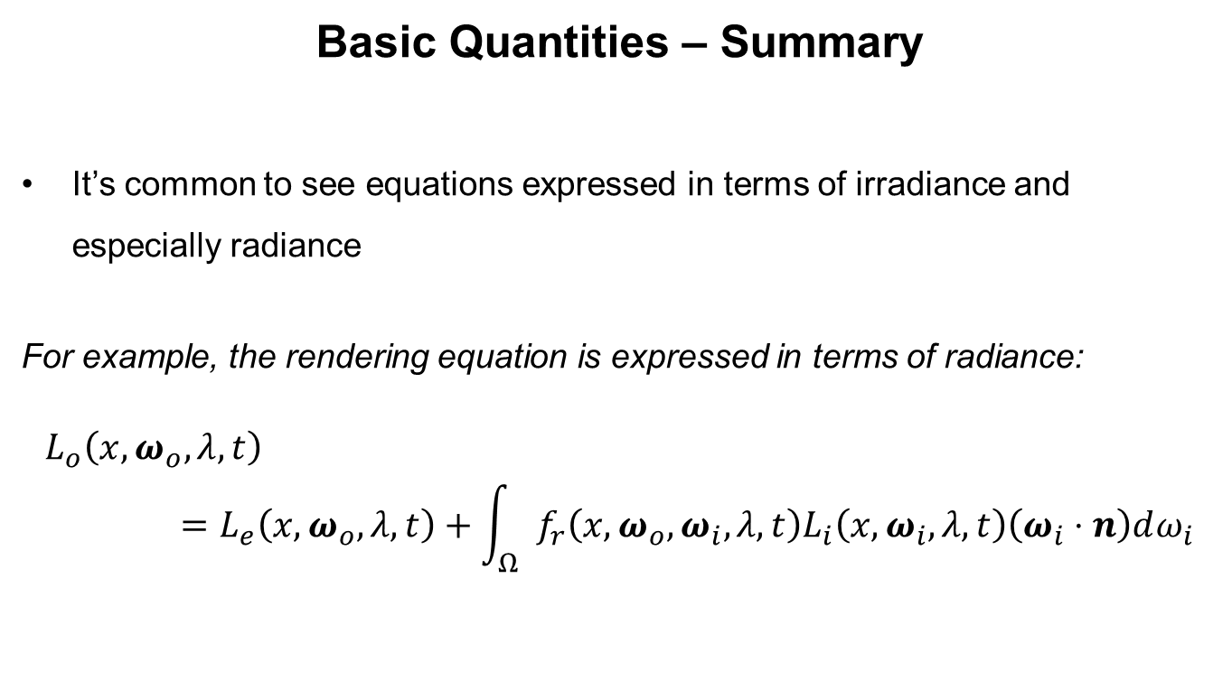
Radiometry
Basic Quantities – Summary
It’s common to see equations expressed in terms of irradiance and especially radiance
For example, the rendering equation is expressed in terms of radiance:
$$L_{o}\left(x,ω_{o},λ,t\right)=L_{e}\left(x,ω_{o},λ,t\right)+\int_{Ω}{f_{r}\left(x,ω_{o},ω_{i},λ,t\right)L_{i}\left(x,ω_{i},λ,t\right)\left(ω_{i}⋅n\right)dω_{i}}$$

Slide 61
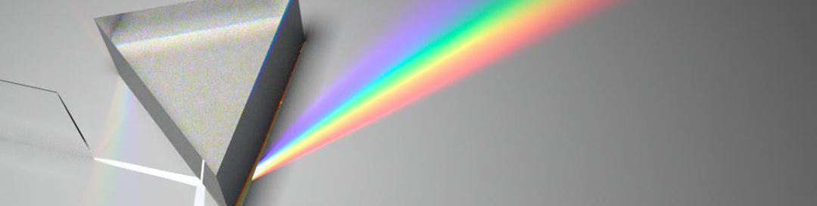
Radiometry
Wavelength Distributions
For accurate colour reproduction we need to consider more than just RGB
We’re not quite there in games yet, but I expect it’s only a matter of time!
For offline rendering, it’s common to use a Spectral Distribution Function
This describes colour over the set of visible wavelengths

Slide 62
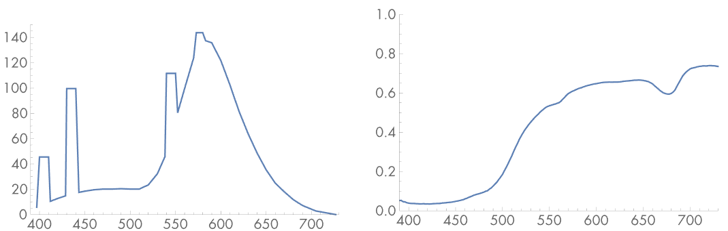
Radiometry
Wavelength Distributions
SDFs usually work with a series of basis functions (similar to splines)
The simplest is a set of point samples spread over the wavelengths
There is no ‘standard’ for this
Fluorescent Light
Lemon Skin
http://www.pbr-book.org/3ed-2018/Color_and_Radiometry/Spectral_Representation.html

Slide 63
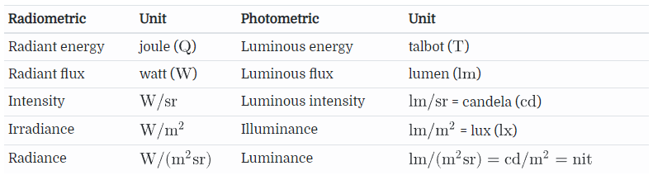
Radiometry
Photometry
Like radiometry, but from perspective of human perception
Can switch between the two by integrating along a spectral response curve
Lots of equivalent units:
http://www.pbr-book.org/3ed-2018/Color_and_Radiometry/Radiometry.html

Slide 64
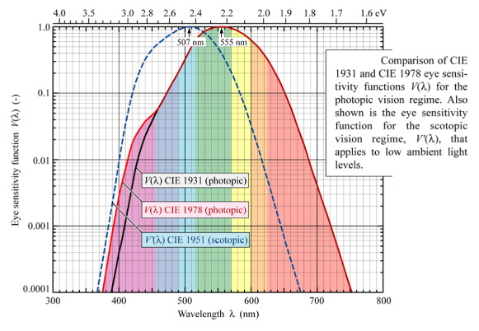
Radiometry
Photometry
Basically, it modulates radiometric terms according to how well our eyes can see certain colours:
https://www.midwest-laser.com/Laser-FAQ/laser-faq.html

Slide 65
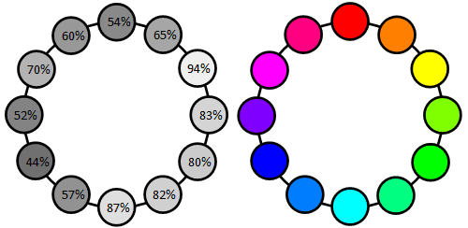
Radiometry
Photometry
Incidentally, this curve explains why certain colours appear brighter than others:
http://www.workwithcolor.com/color-luminance-2233.htm

Slide 66
Radiometry
Photometry
Some interesting values:
(Luminance is the photometry equivalent of Radiance)

Slide 67
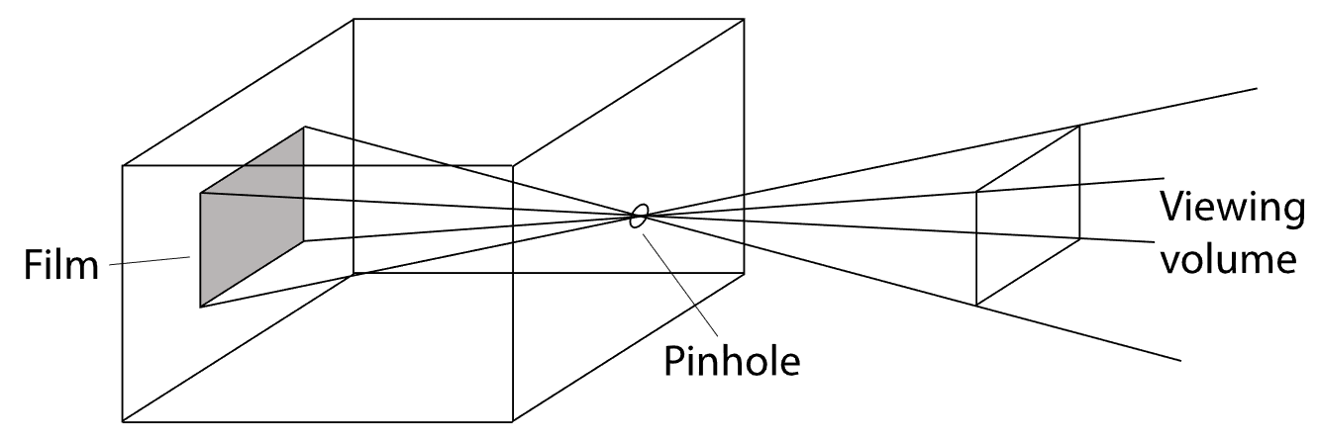
Radiometry
Camera Models
Traditionally we use a pinhole camera model
Easy to define using a projection matrix
Everything is in sharp focus, no distortion or anything else you’d find in a real camera

Slide 68
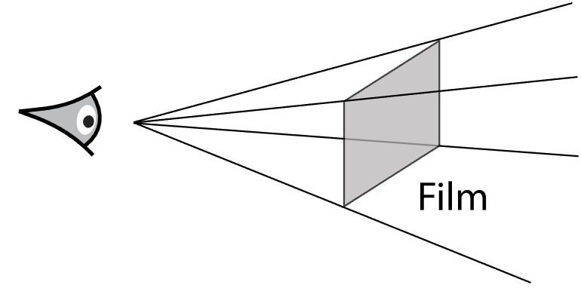
Radiometry
Camera Models
Our simulation of a pinhole camera is conceptually more like this
Look familiar? It’s the start of the ray tracer!

Slide 69

Radiometry
Camera Models
Real cameras are a bit more complicated…

Slide 70

Radiometry
Camera Models: Limitations of Projection Matrix
Real cameras suffer from all sorts of problems
Distortion (barrel / pincushion) means that straight lines end up looking curved
An affine / projective matrix cannot emulate this
https://stackoverflow.com/questions/31879019/image-lens-distortion-correction

Slide 71

Radiometry
Camera Models: Features of Real Lens Systems
There are also issues with:
Uneven focus, edges may be blurred even if centre is sharp
Chromatic aberration (image on right → ) caused by light dispersion because a material will have different refractive indices at different wavelengths
Vignetting, where it gets darker at the edges
Also, more desirable features:
Fixed area in focus
Bokeh (shape of out of focus highlights)
Motion blur (animation looks odd without it)
https://commons.wikimedia.org/wiki/File:Chromatic_aberration_(comparison)_-_enlargement.jpg

Slide 72
Radiometry
Camera Models: Thin Lens Camera
Similar setup to pinhole camera, but has a single lens instead
Assumes the thickness of the lens is negligible
Gives us access to out-of-focus / depth-of-field distortion
Doesn’t simulate any other distortions
Best suited to ray tracing

Slide 73

Radiometry
Camera Models: Realistic Lens Camera
Idea is to emulate a complex lens system
Has to rely on ray tracing
Rather slow
But accurately produces full range of distortion effects
https://www.ephotozine.com/article/olympus-8mm-f-1-8-fisheye-and-7-14mm-f-2-8-lenses-announced-27459

Slide 74
Radiometry
Light Sources
In the real world, area lights dominate (more about this in the shadows theme)
For PBR, we do need to express lights in real-world units
We also need to consider the spectral distribution of the light source
At the very least the ‘colour’
Ideally look at theories based on the light source type, such as black body radiation and colour temperature

Slide 75

Radiometry
BSDF
BRDF =
Bidirectional Reflectance Distribution Function
(Light scattered by a surface reflection)
BTDF =
Bidirectional Transmission Distribution Function
(Light scattering after traveling through surface)
BSDF =
Bidirectional Scattering Distribution Function
(Superset of all BxDF functions)
https://upload.wikimedia.org/wikipedia/en/d/d8/BSDF05_800.png

Slide 76

Radiometry
BSSRDF
Bidirectional surface scattering distribution function
For accurate rendering of translucent surfaces
Light enters medium, exits somewhere else
Other key terms to look up: participating media, volume scattering, phase functions

Slide 77
Radiometry
Sampling and Reconstruction
Basically about antialiasing
We take samples of the incoming radiance
We reconstruct these into a discrete format to give colour to each pixel
Incoming Radiance (continuous)
Pixel Grid (discrete)

Slide 78


Radiometry
Monte Carlo Integration
$$L_{o}\left(x,ω_{o},λ,t\right)=\int_{Ω}{f_{r}\left(x,ω_{o},ω_{i},λ,t\right)L_{i}\left(x,ω_{i},λ,t\right)\left(ω_{i}⋅n\right)dω_{i}}$$
Similarly, to calculate reflected light (outgoing radiance) we cannot actually integrate over the entire hemisphere
Our numerical solution must take samples somehow

Slide 79

Radiometry
Monte Carlo Integration
$$L_{o}\left(x,ω_{o},λ,t\right)=\int_{Ω}{f_{r}\left(x,ω_{o},ω_{i},λ,t\right)L_{i}\left(x,ω_{i},λ,t\right)\left(ω_{i}⋅n\right)dω_{i}}$$
Monte Carlo techniques are based on random sampling
These gradually converge on the correct answer

Slide 80
Radiometry
Conclusion
Where does all this stuff leave us?
Radiometry gives us the formal language for defining the rendering equation
We’ve tied up a few loose ends / opened more cans of worms
We can combine all the theories together to build a high quality ray tracer (see: http://www.pbr-book.org)

Slide 81
Radiometry
Conclusion
Where does all this stuff leave us?
Like it or not, this stuff is coming to real time rendering (actually it’s been here for a while, see Frostbite from 2014)
It looks great, but raises the entry bar significantly
If you’re serious about graphics programming, I really suggest you look into it

Slide 82
Radiometry
Further Reading
Main resource used for these slides: http://www.pbr-book.org
Nice explanation of the basic radiometric terms:
https://marine.rutgers.edu/dmcs/ms552/2009/solidangle.pdf

